Slide 1

Erpx: The AI-powered ERP System
Group No. 15
Project Guide
Ms. Sarala Mary & Ms. Richa Singh
NAME | MOODLE D
Prathamesh Babar | 21107058
Siddanth Arolkar | 22107017

Slide 2
Contents
Abstract
Introduction
Objectives
Literature Review
Research Gap
Problem Definition
Scope
Technological Stack
Proposed System Architecture/Working/Module Diagram
Prototype Design Demonstration
Implementation Status

Slide 3
Abstract
The points to be covered under the Abstract chapter
The AI-Powered ERP System is designed to address major challenges faced by businesses, including the lack of integration between departments, manual processes, limited real-time insights, and slow decision-making. Traditional ERP systems often struggle with handling large data efficiently and adapting to dynamic business needs. Our proposed system uses artificial intelligence to automate workflows, analyze data, and provide predictive insights, thereby enabling faster and smarter decision-making. By integrating core functions like finance, HR, supply chain, and inventory into a single intelligent platform, the AI-Powered ERP System improves accuracy, reduces operational costs, and enhances overall productivity, helping organizations respond proactively to changing market conditions.

Slide 4
Introduction
In today’s competitive business world, organizations face challenges such as disconnected processes across departments, manual handling of large data, a lack of real-time insights, and delays in critical decision-making.
Traditional ERP systems attempt to integrate business functions but remain limited in adaptability, speed, and intelligence, making them less effective in fast-changing markets.
Most existing ERP solutions provide only historical data reports instead of predictive insights, leading to slower responses and missed opportunities.
Businesses also struggle with high operational costs, data duplication, inefficiencies, and errors caused by outdated or rigid ERP systems.
These persisting issues highlight the urgent need for an advanced ERP solution powered by Artificial Intelligence to enable automation, predictive analytics, and smarter decision-making for improved productivity.

Slide 5
Motivation
Companies spend significant time and resources managing routine processes, but still face inefficiencies.
Challenges like delayed financial reporting, errors in HR data, and difficulty in tracking inventory highlight gaps in traditional ERP systems.
Current ERP tools often lack real-time insights and predictive capabilities, slowing down decision-making.
The successful use of Artificial Intelligence in sectors like healthcare, banking, and retail shows that efficiency and accuracy can be greatly improved.
Businesses face increasing competition, requiring faster and more accurate decisions.
Manual processes in traditional ERP systems are prone to errors, causing delays and extra costs.
Integrating AI can help companies streamline operations and uncover patterns and insights that were previously hard to detect.

Slide 6
Objectives
Automate Routine Processes: Reduce manual work in finance, HR, inventory, and other departments, minimizing human errors and saving time.
Predictive Analytics: Use AI to analyze historical data and provide forecasts, helping management make faster, data-driven decisions.
Real-Time Reporting: Generate instant reports and interactive dashboards to monitor operations, track performance, and identify issues quickly.
Enhance Efficiency and Accuracy: Streamline workflows across all business modules to improve productivity and reduce operational delays.
Intelligent Decision Support: Provide actionable insights and recommendations through AI, enabling strategic planning, resource optimization, and proactive problem-solving.

Slide 7
Literature Review
The points to be covered under literature survey chapter:
Survey of the existing solutions in the real world.
Analysis of the issues present in the surveyed solutions.
Survey of the people who use these solutions / potential users of this solution w.r.t. their requirements and improvements expected.
Survey of the technologies and methodologies used in the existing solutions.
Categorized listing of the technologies and methodologies used in the existing solutions w.r.t. limitations, advantages and / or results achieved.
General overall observations of the survey as the concluding paragraph.

Slide 8
Literature Review
Sr.no | Title | Author(s) | Year | Methodology | Drawback
1 | Transforming ERP systems with collaborative AI: Paving the path to strategic growth and sustainability | M. A. Mannan, A. Shaikh, A. A. Khan | 2025 | Conceptual framework analyzing how collaborative AI can be integrated into ERP systems; includes theoretical models and strategic scenarios for growth and sustainability in businesses. | Lacks empirical validation; results are not tested on real ERP systems; potential implementation challenges in diverse industries not addressed.
2 | Optimization of ERP Systems in the Healthcare Industry Using Artificial Intelligence | Geetha Priya Thiyagarajan, Benita S Monica | 2025 | AI modules like NLP, ML, RPA integrated into healthcare ERP for decision support and efficiency | Complexity of integrating AI with existing systems; difficulty in making smart, flexible ERP decisions
3 | Integration of Artificial Intelligence (AI) in Enterprise Resource Planning | Vidhyalakshmi Kumar, Hema Thangaraj, K. Siva Kumar | 2024 | Literature review and survey-driven study analyzing AI-based predictive analytics, automation, and personalized UI in ERP. | Resistance to organizational change; data quality and readiness issues impact implementation.

Slide 9
4 | Investigating AI Model Use in ERP Cloud-Based Systems | Nikhitha Yathiraju, Bhavani Srinivas, Veena Reddy | 2022 | Qualitative study capturing Indian IT professionals’ perceptions on AI and ML integration in cloud-based ERP systems. | Issues in security, resource demands, and integration complexity in cloud ERP with AI.
5 | Leveraging AI for Developing Future Intelligent ERP System | S. Rajesh Kumar, Anil K. Gupta, Praveen Kumar | 2023 | Exploratory research on AI techniques, including ML and deep learning, for future intelligent ERP system capabilities. | Most technologies are still emerging and lack full industrial deployment readiness.
6 | AI-Driven ERP Use Cases in Indian SMEs | Ahex Technologies Research Team (R. Nair, M. Sharma) | 2025 | Case studies on AI modules in ERP focused on recruitment automation, sales predictions, and manufacturing optimization in SMEs. | Need for high customization per SME; integration complexity due to varied business models.
7 | Open-AI Powered Intelligent ERP Solutions | R. Srinivas, M. Deepa, S. Kumar | 2023 | Proposed AI/ML integration framework for ERP including chatbots, automation, and communication improvements using OpenAI tech. | Integration challenges and dependencies on rapidly evolving AI technology landscapes.

Slide 10
8 | AI and ERP Integration: Challenges in Indian Context | P. Chandra, N. Rao, D. Singh | 2024 | Mixed methods study including surveys and interviews assessing AI-ERP implementation barriers in Indian industries. | Data privacy, regulatory compliance, and resource constraints affect AI adoption.
9 | Role of AI in Transforming ERP Systems in India | R. Nagarajan, S. Desai, M. Patel | 2025 | Industrial insights on AI-powered ERP automation, NLP, and user experience improvements gathered from Indian business cases. | Requires continuous AI model updates and comprehensive user training programs.
10 | AI in ERP: Benefits, Examples & Challenges | V. Sharma, R. Gupta | 2025 | Compilation and analysis of AI innovations across ERP modules including finance, supply chain, and customer management. | Data quality issues and significant organizational change management challenges.
11 | Next Gen: AI Powered ERP | R. Kenge, S. Singh, P. Yadav |  | Research focused on AI-enabled ERP architecture covering scalability, security, and real-time decision-making frameworks. | Complex integration with existing ERP, and demand for extensive user training.

Slide 11
Research Gap(Limitations of existing systems)
ERP projects like NetSuite often face problems such as unclear planning, data migration errors, and user resistance, which lead to delays or failures in the early stages. This shows the issue is not fully solved yet.
Setting clear goals, strong leadership, and thorough testing greatly improve chances of success. Also, cleaning data well before migration and ongoing user training help a smoother system adoption.
From a technology view, cloud-based ERP with AI-powered analytics and automation works better than traditional systems. Step-by-step rollout and focus on user-friendly design make implementation easier.
There is confidence in addressing some challenges by combining good planning, change management, and AI tools. The next chapters will explain a detailed approach and justify how it can solve these problems effectively.

Slide 12
Problem Definition
Data Integration & Quality Issues – Current ERP systems struggle with fragmented and inconsistent data, leading to inefficiencies in reporting and decision-making. ERPx will integrate AI-driven pipelines to ensure real-time, clean, and reliable data flow.
Lack of Predictive & Intelligent Capabilities – Traditional ERP is reactive, not proactive. ERPx will embed AI/ML for forecasting, anomaly detection, and automated insights, enabling faster and more accurate decision-making.
User Experience Complexity – Legacy ERP systems are difficult to use, requiring technical expertise. ERPx will introduce conversational AI (chatbots, NLP) and intelligent dashboards to simplify interaction and accessibility for all users.
Limited Adaptability to Modern Business Needs – ERP systems fail to keep up with changing business demands and external disruptions. ERPx will leverage scalable AI architectures and modular ERP enhancements to ensure adaptability, efficiency, and competitiveness.

Slide 13
Scope
Incorporating AI and ML models into Finance, HR, Supply Chain, and CRM modules to provide automation, predictive analytics, and decision support.
Building data pipelines and dashboards for continuous monitoring and faster insights, enabling businesses to act proactively rather than reactively
Implementing NLP-based chatbots and intelligent assistants to simplify ERP operations and make the system more user-friendly.
Using AI techniques to detect fraudulent transactions, cybersecurity risks, and anomalies within ERP workflows to ensure reliability and trust.

Slide 14
Technological Stack
Frontend: React.js, HTML, CSS, JavaScript.
Backend: Python / FastAPI or Node.js for business logic and APIs.
Database: MySQL or PostgreSQL for storing ERP data.
AI Layer: Machine Learning models, LLM integration, predictive engine.
Integration: REST APIs and cloud-based services.

Slide 15
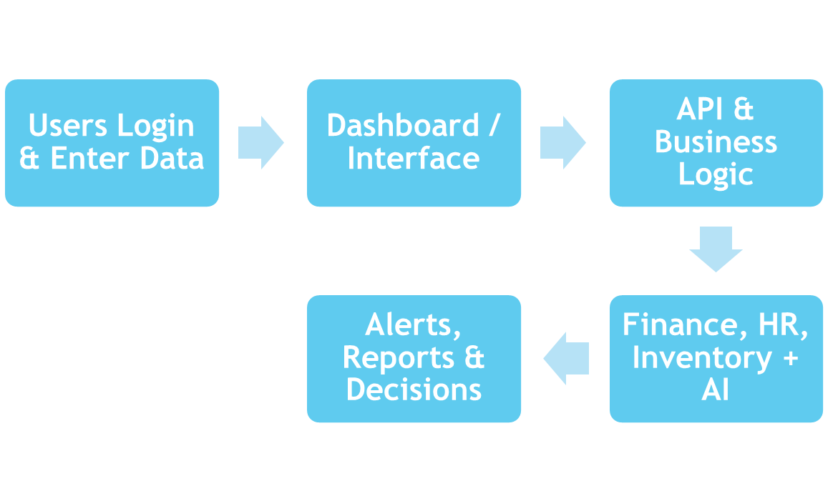
Proposed system architecture/Working/Module Diagram

Slide 16
References
Siar Sarferaz. “Implementing Generative AI into ERP Software,” IEEE Access, vol. PP, no. 99, pp. 1–1, 2025.
Sunil Kumar Sehrawat. “The Role of Artificial Intelligence in ERP Automation: State-of-the-Art and Future Directions,” IJS DCS / TLAI, Mar 2023
Neha Soni, Enakshi Khular Sharma, Narotam Singh, Amita Kapoor. “Impact of Artificial Intelligence on Businesses: from Research, Innovation, Market Deployment to Future Shifts in Business Models,” arXiv preprint, 2019.

Slide 17
Thank You...!!

